Slide 1
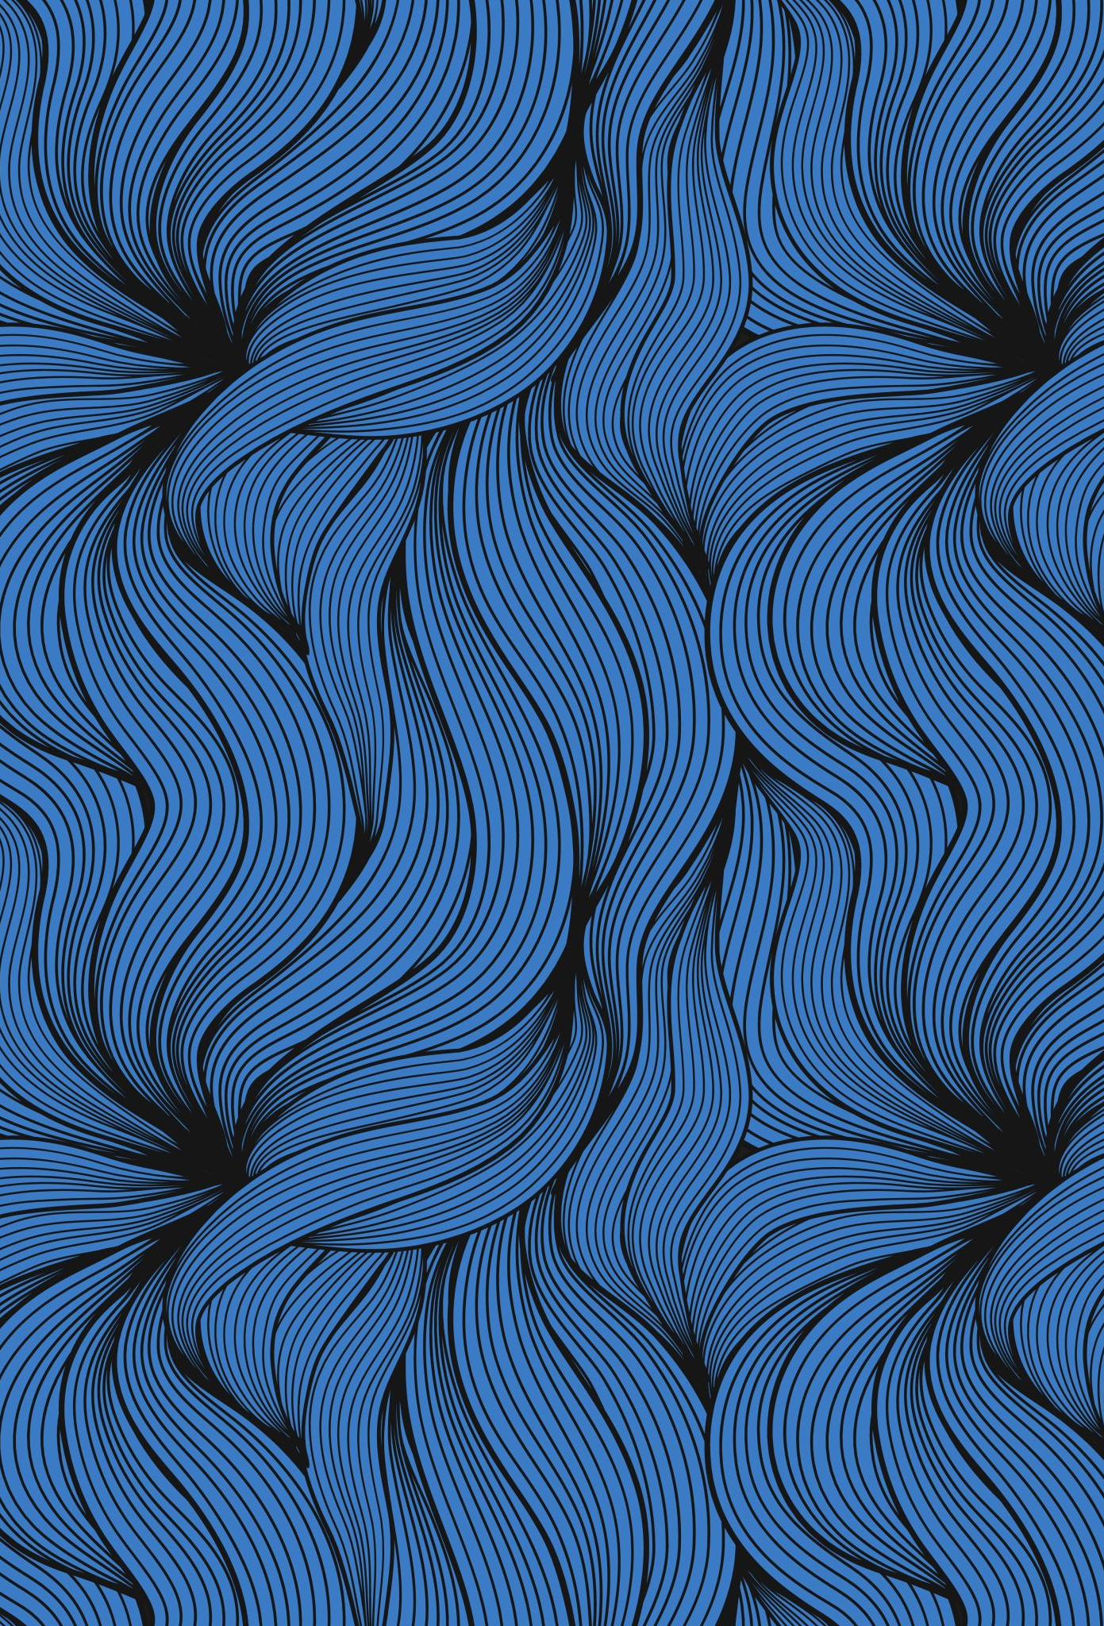
Generative structural design
By: Kurt Soncco
PI: Luis Ceferino, PhD

Slide 2
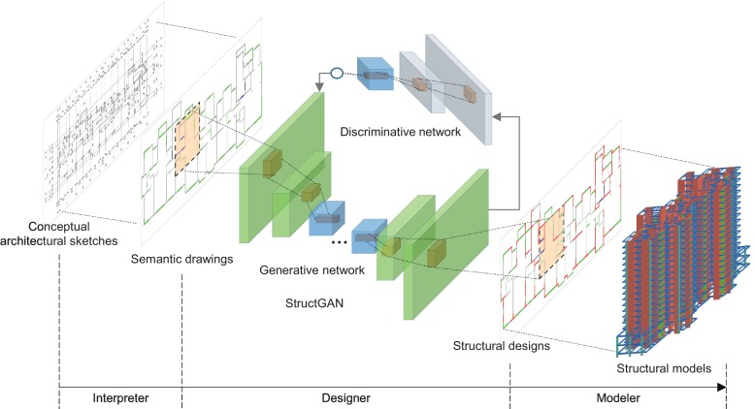
Paper: Automated structural design of shear wall residential buildings using generative adversarial networks

Slide 3
Paper: Automated structural design of shear wall residential buildings using generative adversarial networks

Slide 4
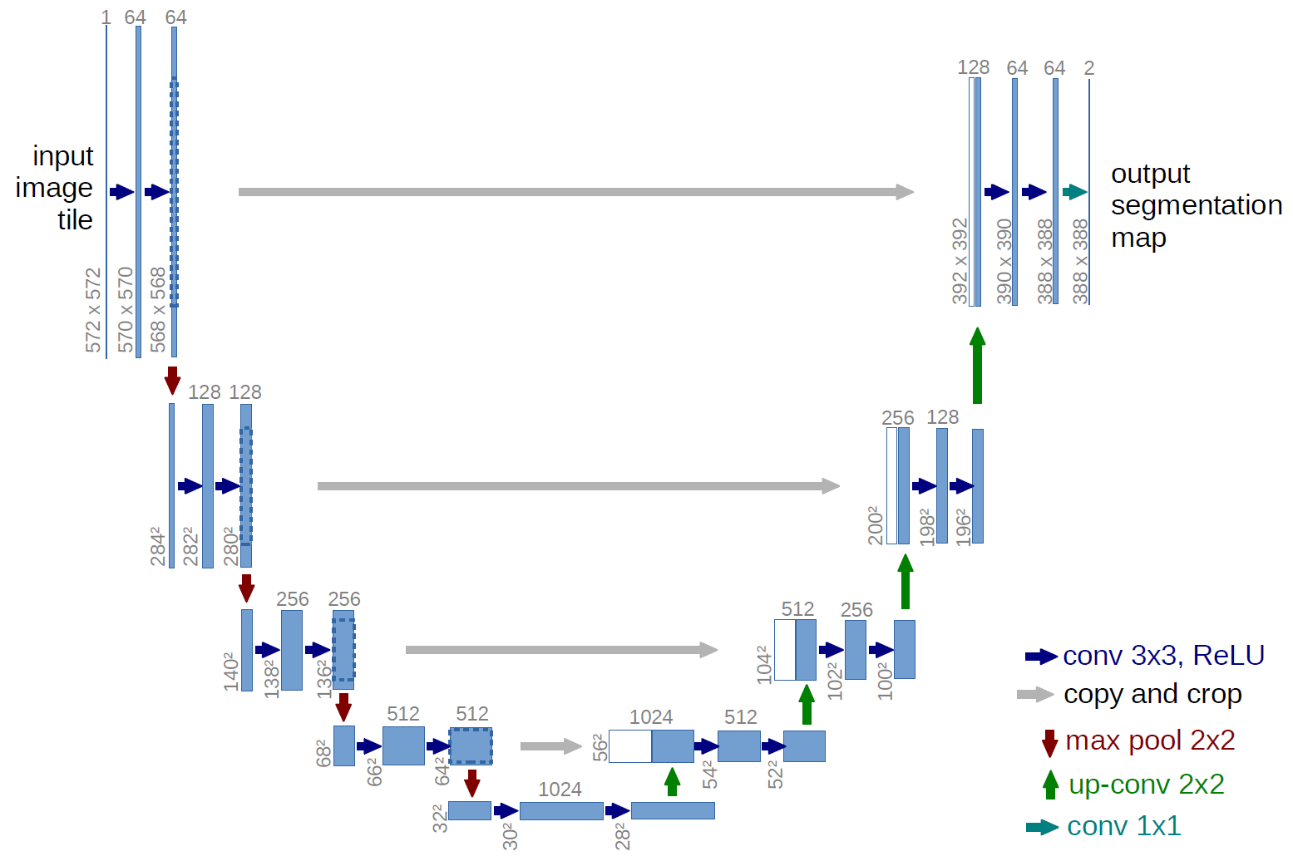
Approach
Dataset:
193 plans views
Model:
UNet: 4 Encoder+Decoder
PatchDiscriminator:
Pixel2Pixel Loss

Slide 5
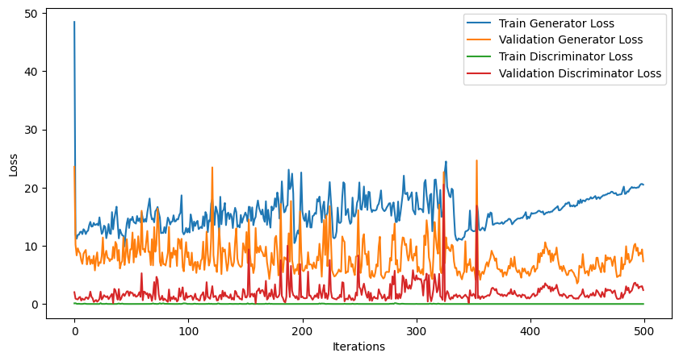
Results

Slide 6
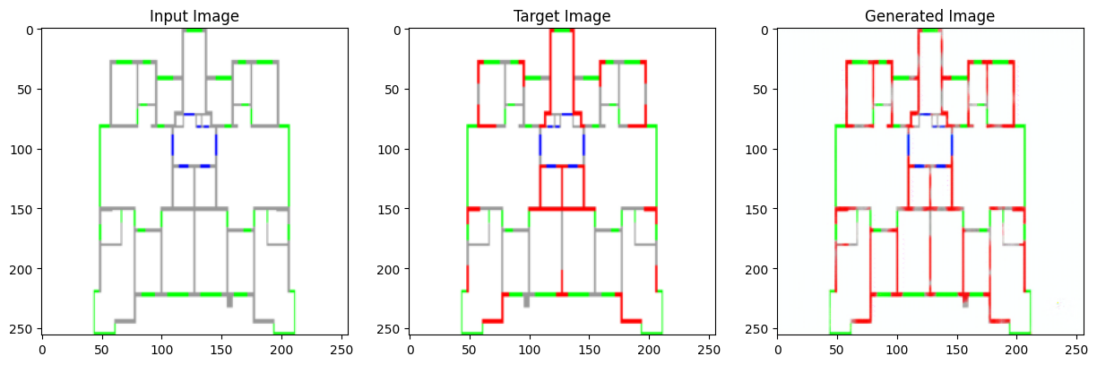
Preliminary results

Slide 7
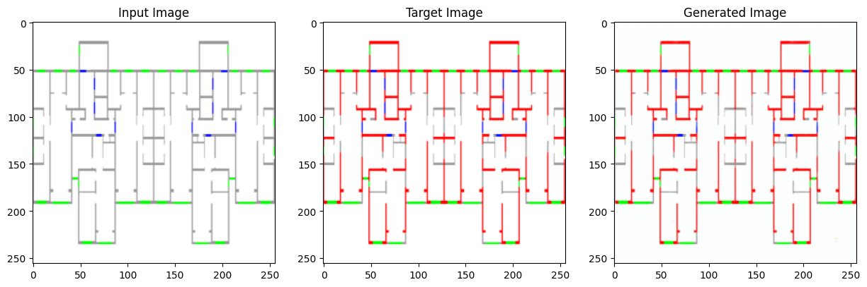
Preliminary results

Slide 8
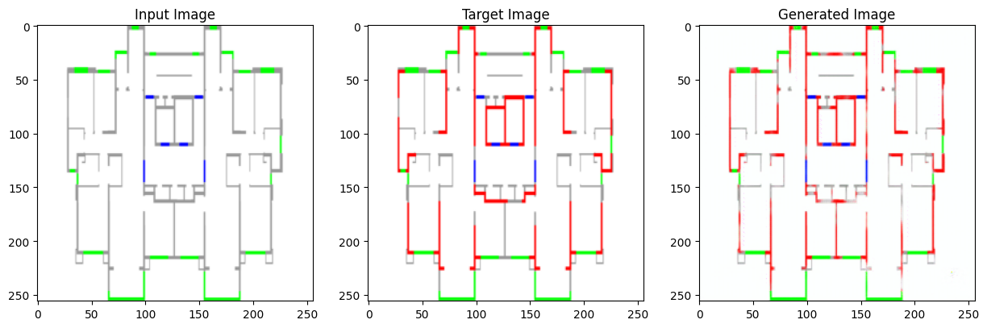
Preliminary results

